Slide 1
Automating SPEC REVIEWS FOR THE CPI
Avena Cheng
Data Science Fellow
Office of Prices and Living Conditions

Slide 2
OVERVIEW
BACKGROUND
The CPI requires products to be reviewed by Commodity Analysts every month to calculate price indices.
PROBLEM
Currently < 25% of new items and < 12% of current items require a CA’s attention
The current system filter has a 29% accuracy.
GOAL/IMPACT
Use machine learning to automate the review process and save time, money, and labor.

Slide 3
INFRASTUCTURE
Reviews w/ change
Triggered
Goes to CA
SYSTEM FILTER
Model
Reviews w/ no change
Incoming Quotes
Filtered
Quotes
Doesn’t go to CA
Not
Triggered

Slide 4
Data science Approach
Explore, clean and merge datasets
Model Building
  Logistic Regression, Random Forest, XGBoost, Neural Net, Naïve Bayes, etc.
Feature Engineering
  View feature importance to identify underlying patterns/relationships
  Create new features that may be used to improve the model
Cross – Validation / Testing
  Use cross validation to verify the accuracy of your model
  Test with new, unseen data

Slide 5
NOTES ABOUT THE DATA
Used quote, spec, spec_changes, and review datasets
Data includes new variables:
  Outlet_quote (primary key), ca_made_change_affecting_index, triggered
Target Variable: “Review”
Triggered | CA made change | Review
Y | Y | Y
N | Y | Y
N | N | N
Y | N | N

Slide 6
DATA PREPROCESSING
Dealing with missing values
  We can’t just “drop” them
Creating target variable “review”
Selecting predictive features
  Ex: price change, field messages
Dropping features that relate to the target variable
  Ex: CA msg
Creating new features

Slide 7
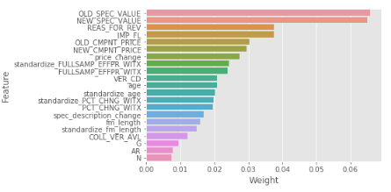
FEATURE ENGINEERING
  Tried to extract the cost of shipping, alteration charges, and items that were sold as separates as different features
  Tried using key words in the field messages
  Tried to rank the specs in alphanumeric order
  Tried to find the difference in spec values
  Extracted F codes from field messages
  Tried using season
  Found length of field message
  Oversampling minority class
  Tried using the age of the quote
  Standardized price changes
  One-hotted categorical variables
  TF-IDF

Slide 8
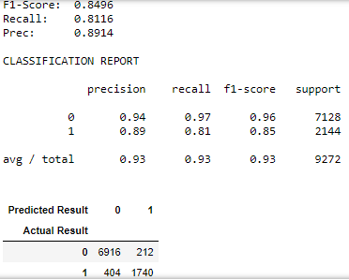
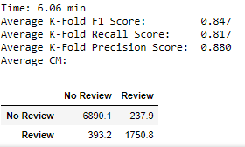
PREDICTIONS
Hold out method
Cross Validated

Slide 9
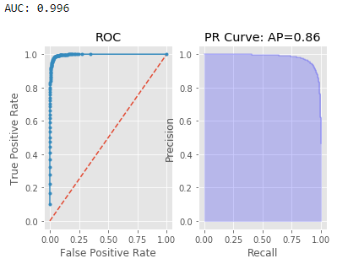
Model progress
→ I used F1-score, Recall, and Precision as my accuracy metrics
Model | F1 | Recall | Prec
System | 0.282 | 1.0 | 0.164
Random Forest | 0.78 | 0.97 | 0.65
SGD Classifier | 0.53 | 0.91 | 0.38
Neural Net | 0.53 | 0.93 | 0.37
Naïve Bayes | 0.57 | 0.93 | 0.41
Logistic Regression | 0.57 | 0.91 | 0.41

Slide 10

Understanding the metrics
F1 score is the harmonic mean of precision and recall.
Recall is how many relevant instances the model predicts
Precision is how many relevant instances the model predicts correctly
Precision is calculated as: $\frac{TRUE POSITIVES}{TRUE POSITIVES+FALSE POSITIVES}$
Recall is calculated as: $\frac{TRUE POSITIVES}{TRUE POSITIVES+FALSE NEGATIVES}$
Goal: Increase both precision and recall scores by reducing the number of false positives/negatives
We want to reduce this number.
False Negative means the model
predicts no review when it should
be reviewed.

Slide 11
Random ForesT:
Explanation, PROS & CONS, WHAT I’ve DONE, NEXT STEPs

Slide 12
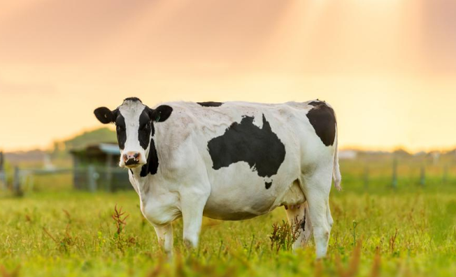
Random Forest Model
Can you guess the weight of this cow?
  One person guesses from the little knowledge they have about a cow
  Put a lot of them together and you get closer to the true results
  This is how random forest works.
Uses multiple decision trees that together average toward the true value
  Selects random features (columns) in your dataset and creates a decision tree out of it (each person has some idea of the cow)
  The decision tree outputs a result and gets counted (the person’s guess)
  We take the majority of this list to classify the instance
‘WISDOM OF THE CROWD’

Slide 13
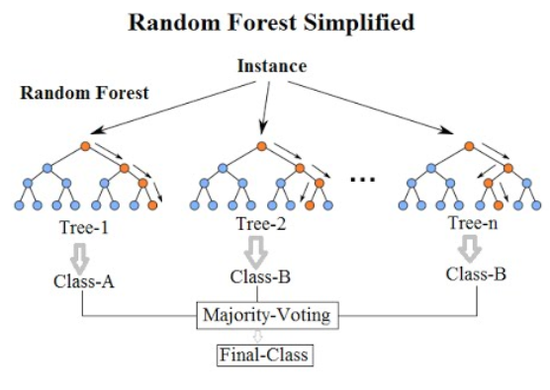

Slide 14
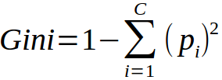
Pros and Cons to RF
CONS:
Bias to high cardinality features (features that have very few instances)
  Example: prices (38.04, 46.76, 100.10)
Unfriendly toward categorical features
  Models only take numerical values
  In order to deal with categorical features, we can either rank them or “one-hot” them
  RF uses formula called “gini” to determine how to split. Gini favors many classes
PROS:
Very strong predictor compared to other models
Fast runtime (only takes a few seconds compared to logistic regression)
Low variance, relatively low bias
  Less likely to over-fit
  Easier to generalize

Slide 15
PERFORMANCE ON OTHER SECTIONS
Section | F1 | Recall | Prec
Apparel | 0.78 | 0.97 | 0.65
Housing | 0.87 | 0.97 | 0.79
Food | 0.79 | 0.90 | 0.70
Education & Communication | 0.88 | 0.99 | 0.79
Transportation | 0.84 | 0.97 | 0.74
Medical | 0.93 | 1.0 | 0.876
Recreation | 0.85 | 0.98 | 0.78
Goods and Services | 0.87 | 0.96 | 0.81
F1 Avg: 0.85
Recall Avg: 0.97
Prec Avg: 0.77

Slide 16
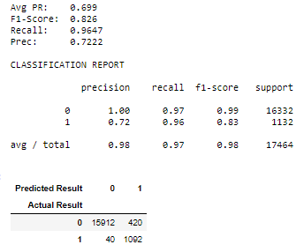
APPAREL MODEL
Threshold = 0.35

Slide 17
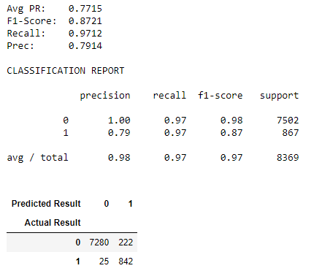
HOUSING MODEL
Threshold = 0.3

Slide 18
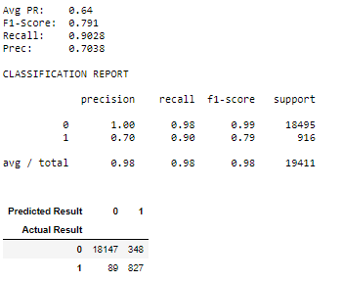
FOOD MODEL
Threshold = 0.3

Slide 19
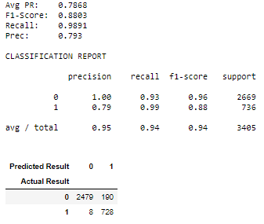
EDUC&COMM MODEL
Threshold = 0.2

Slide 20
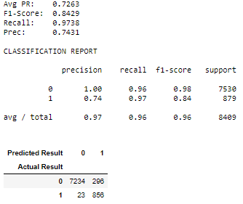
Transportation MODEL
Threshold = 0.2

Slide 21
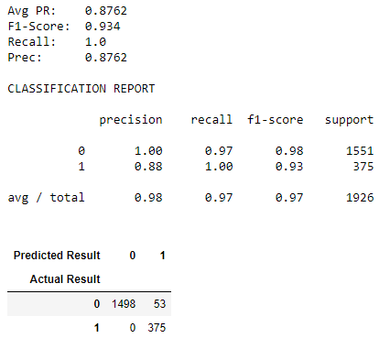
MEDICAL MODEL
Threshold = 0.28

Slide 22
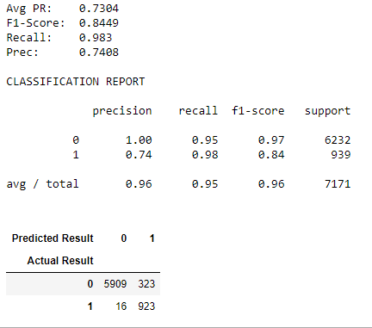
RECREATION MODEL
Threshold = 0.2

Slide 23
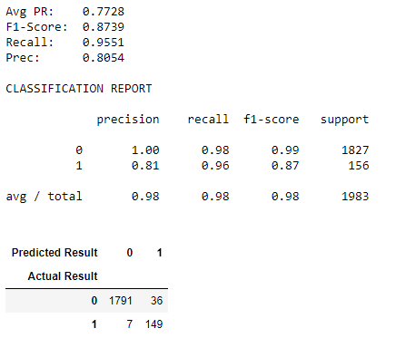
GOODS & SERVICES MODEL
Threshold = 0.3

Slide 24
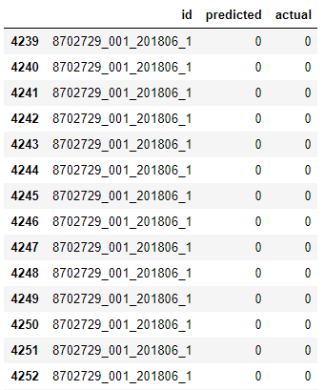
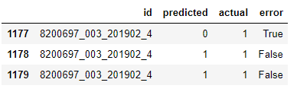
CHALLENGES
Some items can have multiple predictions
Same item can have different predictions

Slide 25

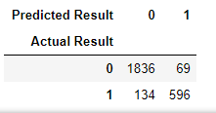
Solution 1
Reshape data so that one row = one item
Results:
→ F1 Score is the same, but we want a high recall (at least 0.95)

Slide 26
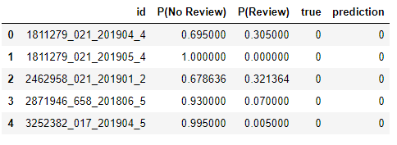
Solution 2
Step 1- Adjust probability thresholds
Ex: if threshold = 0.2, model predicts the class probability > 0.2 to be “review”
Step 2 – Adjust Class Majority
Default Threshold: 0.5

Slide 27
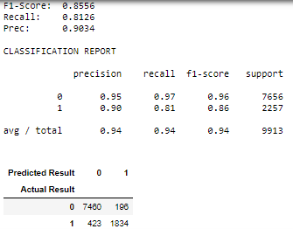
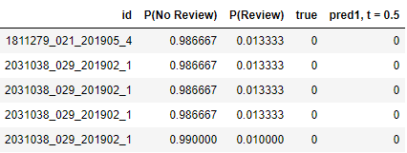
Default threshold
Predicted
No Review Review
7460 | 196
423 | 1823
Actual
(FP)
Review No Review
(FN)
FP = False Positive
FN = False Negative
Adjusted Class Majority

Slide 28
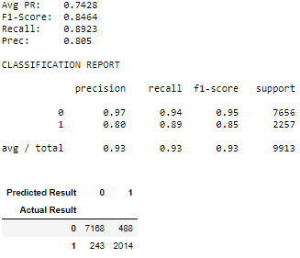
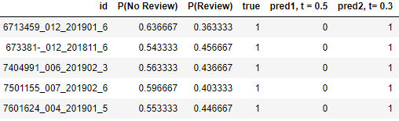
1. Adjust Probability Threshold
Predicted
No Review Review
7168 | 488
243 | 2014
(FP)
Review No Review
Actual
(FN)
FP = False Positive
FN = False Negative

Slide 29
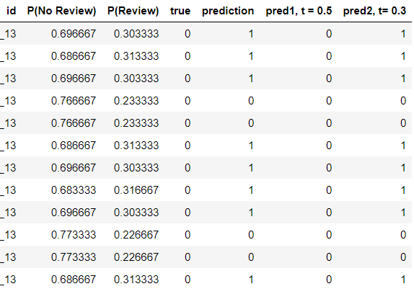
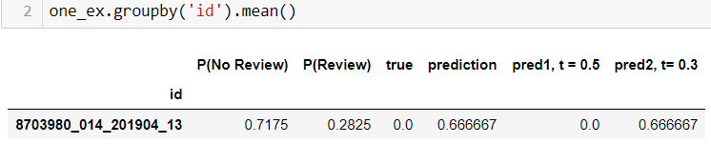
1. Adjust CLASS MAJORITY
# of 1: 8
Total: 12
8/12 = 0.6667
Final prediction
= 1

Slide 30
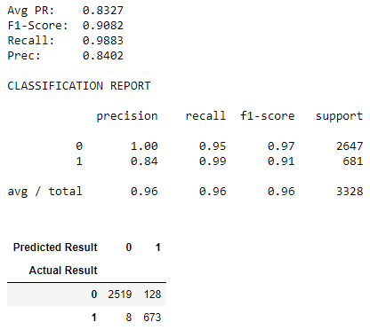
FINAL
Predicted
No Review Review
2519 | 128
8 | 673
Actual
(FP)
Review No Review
(FN)
FP = False Positive
FN = False Negative
Adjusted Class Majority

Slide 31
Overall impact
Total Avg Percentage of Reviews Decreased: 85%
Percentage decreased from each category:
  Apparel: 90%
  Housing: 87%
  Food: 94%
  Educ/Comm: 73%
  Transportation: 86%
  Medical: 78%
  Recreation: 83%
  Goods/Services: 88%

Slide 32
CONCLUSIONS
Models need to be retrained on a yearly, bi-annual, or even seasonal basis
Probability thresholds can be adjusted based on how much you of each error you want
Class majority threshold can be also be adjusted.

Slide 33
Resources for Understanding Random Forest
What is Random Forest: https://towardsdatascience.com/understanding-random-forest-58381e0602d2
Understanding Parameters: https://medium.com/@taplapinger/tuning-a-random-forest-classifier-1b252d1dde92
What is the Gini Index: http://www.learnbymarketing.com/481/decision-tree-flavors-gini-info-gain/

Slide 34
THANK YOU!

